Slide 1
V&V

Slide 2
Main Phases
Development
deployment
Operation
retirement
Maintenance
t

Slide 3
Development
Requirements
definition
Req. inspection
Requirement document
Design
Des. inspection
Design document
Implemen
tation
Code inspection + test
Code
Project management
Configuration management
t

Slide 4
V&V
Validation
is it the right software system?
effectiveness
external (vs user)
reliability
Verification
is the software system right?
efficiency
internal (correctness of vertical transformations)
correctness

Slide 5
V & V
Requirement
document
Design document
validation
stakeholders
verification
Unit
Unit
System
Notes:
Verification is about checking transformation from one doc to another, and internal consistency of docs
Validation is about (especially at beginning and at end – but at end too late) doc/product and what stakeholder (user, commissioner) wants

Slide 6
Scenario1 in a dev process
Stakeholder
Real need: big car /6 seats
Developers
R1: compact car (4 seats)
Result : compact car (4 seats)
Verification: passed
Validation : not passed

Slide 7
Scenario2 in a dev process
Stakeholder
Real need: big car /6 seats
Developers
R1: big car (6 seats)
Result : big car (6 seats)
Verification: passed
Validation : passed

Slide 8
Scenario3 in a dev process
Stakeholder
Real need: big car /6 seats
Developers
R1: big car (6 seats)
Result : compact car (4 seats)
Verification: not passed
Validation : passed on req doc, not passed on delivered product

Slide 9
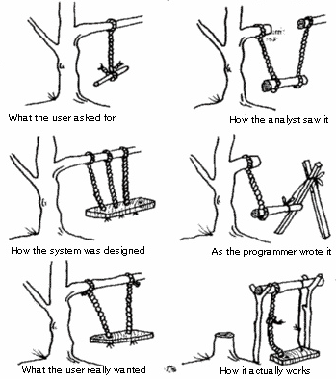
Requirements
The root…
…of all evils

Slide 10

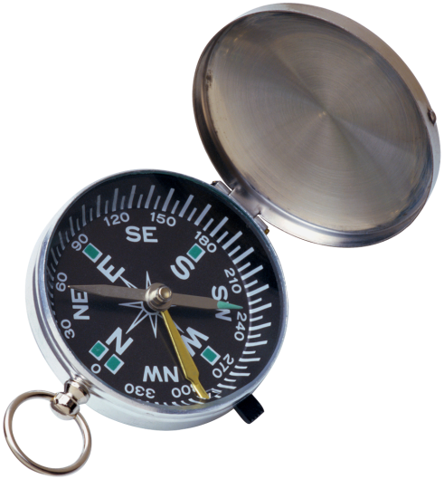

Traceability
if( i = j ){
…
Requirement
Design Item
Code
Fragment
Use case
Test
case
Test result
Failure

Slide 11
V & V vs. cost of fixing defect
Requirement
document
Cost of fixing defect
Design document
Unit
Unit
System

Slide 12
Failure, fault, defect
Failure
An execution event where the software behaves in an unexpected way
Fault
The feature of software that causes a failure
May be due to:
An error in code
Incomplete/incorrect requirements
Defect
Failure or fault

Slide 13
Failure fault defect
Defect
causes
Fault
Failure
1, *
0,*

Slide 14
Bicycle
Failure Requirements
User falls down R1 transport person
R1 not satisfied
Why?

Slide 15
Bicycle
Fault
where the failure comes from?
Handlebar ill mounted? (implementation pb)
Saddle too high? (configuration pb)
Wheels too far apart? (design problem)
User cannot bike? (not a bycicle failure)
Pothole in the road? (not a bycicle failure)

Slide 16
Insertion / removal
Defect is characterized by
Insertion activity (phase)
Removal activity (phase)
insertion
discover
time
removal

Slide 17
Basic goal of VV
Minimize number of defects inserted
Cannot be zero due to inherent complexity of software
Maximize number of defects discovered and removed
Minimize time span between insertion and discover and removal

Slide 18
Insertion/removal by phase – typical scenario

Slide 19
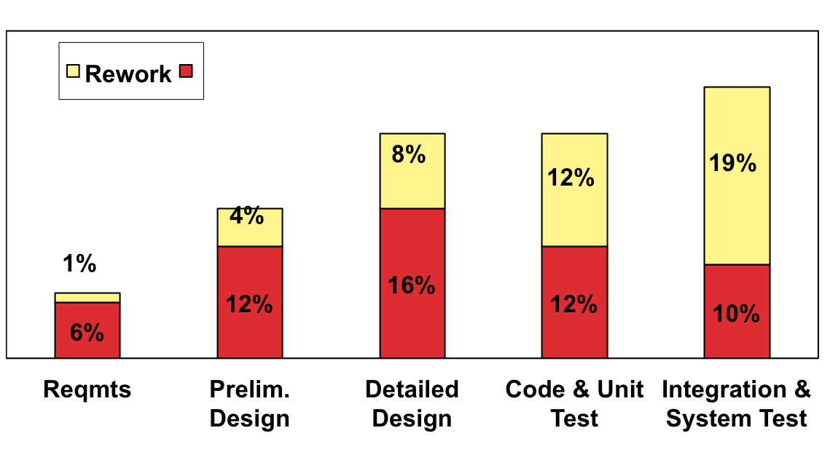
Rework Problem
The longer the delay insert-remove, the higher the cost of removing defect
Avoidable rework accounts for 40-50% of development [Boehm, 1987; Boehm&Basili, 2001]
More recent data available at www.cebase.org

Slide 20
Cost of quality vs cost of non quality
Development
deployment
Operation
Maintenance
Cost of quality (all V&V activities)
Cost of non quality (defect fixing)

Slide 21
Who pays?
Development
deployment
Operation
Maintenance
Cost of quality (all V&V activities)
Cost of non quality (defect fixing)
Developer pays
Developer pays (warranty period) User pays (after warranty period

Slide 22
Who pays
Non quality can be a profitable bargain for developer if the user is the one who pays for it
See also lock in:
Cost to switch from one vendor (developer) to another is always high for the user, so user is forced to keep the existing developer
Deciding who (user or developer) is responsible for a defect is often difficult, typically because of unclear requirements

Slide 23
Technical debt
Concept to define the trade off quality vs non quality
Debt: money borrowed today, returned in the future, plus interest
Technical debt: effort not spent today, to be spent tomorrow, plus interest

Slide 24
Technical debt
Ex:
Variables with non meaningful names
Int a, int aa, int aaa
Fast to write today, but what do they actually represent ? Understanding the program will be much harder later
Code clones
Faster to do cut and paste today instead of defining a function. Will require more effort in maintenance later (ex fix defect 3 times, if code was cloned 3 times)

Slide 26
V&V techniques - types
Static
inspections
source code analysis
Dynamic
testing

Slide 27
V&V techniques – per activity
Requirements
Inspection of requirement document (static)
GUI prototype (static)
Product prototype (dynamic)
Design
Inspection of design document (static)
Implementation
Test (unit, integration, application) (dyn)
Inspection of source code (static)

Slide 28
Inspections

Slide 29
Inspections
Static
inspections
source code analysis
Dynamic
testing

Slide 30
Development
Requirements
definition
Req. inspection
Requirement document
Design
Des. inspection
Design document
Implemen
tation
Code inspection + test
Code
Project management
Configuration management
t

Slide 31
Inspections
Requirements engineering
Requirement
document
VV requirements
Requirement
document
Design .
VV design
Design
document
Design
document
Implement unit
VV unit
Unit
Unit
Implement unit
Unit
VV unit
Unit
Integrate units
System
VV system
System
Project management Configuration management Quality assurance

Slide 32
Inspection
Consists in
reading documents/code
By a group of people (3+, group dynamics)
With goal of finding defects (no correction)
Variants of inspections
Reading techniques, walkthroughs, reviews
Can find many defects
Test concentrates one defect at a time

Slide 33
Inspection
Advantages
Can be applied to documents
Requirements, design, test cases, ..
Can be applied to code
Does not require execution environment
Is very effective
Reuses experience and know of people on domain and technologies
Has more global view (vs test: one defect at a time)
Uses group dynamics
Limits
More suitable for functional aspects
Requires time (effort and calendar time)

Slide 34
Benefits
Early defect detection improves product quality and reduces avoidable rework (down to 10-20%)
Data from industry averages [Capers Jones, 1991]
more data available at www.cebase.org
Requirements
Insp.
5 (20)
Defects per KLOC passed with inspection
Design
Insp.
8 (40)
Defects per KLOC passed without inspection
Code
Insp.
15 (100)
Unit Test
Insp.
7 (50)
Integration Test
Insp.
3 (20)
System Test
Insp.
1 (10)
Rework Costs

Slide 35
Inspection vs. testing
Complementary techniques
Both should be used in V and V

Slide 36
Roles in group
Moderator:
Leads inspection process and notably inspection meeting
Selects participants, prepares material
Usually not from project that produces document to be inspected
Readers:
Read document to be inspected
Author
Answers to questions that arise
Scribe
Writes inspection log

Slide 37
Fagan Inspection Process
Select team, arrange materials, schedule dates
Present process, product
Become familiar with the product
Team analysis to find defects
Correct defects
Verify fixes, collect data
Planning
Overview
Preparation
Preparation
Preparation
Inspectors are
often unprepared.
How to make
visible the
quality of
preparation?
Inspection Meeting
Rework
Follow-Up

Slide 38
Process
Overview
Quickly present inspection to group goals and document to be inspected
Preparation
Read individually (applying inspection technique)
Meeting
Group reads, discusses issues, agrees on problems. Scribe logs problems. Moderator keeps focus, keeps pace, stops (long) discussions
Rework
Author fixes defects/problems
Follow up
Repeat inspection or close and pass to next phase

Slide 39
Prerequisites for successful inspections
Commitment from management
Effort invested upfront, that “does not produce anything”
Find defects, not fix them
Document under inspection meets quality standards
Results not used to evaluate people (and notably author)
Constructive approach
Group aims to produce best possible document
No “kill the author” game
No “relax and chat” meetings

Slide 40
Techniques vs. document
Ad hoc (code, requirements, design)
Just read it
Defect taxonomy (code, requirements, design)
Categories of common defects
Checklist (code, requirements, design)
Questions/controls to be applied
Code
Author or reader ‘executes’ code
Reader reconstructs goal of code from code
Reader defines and applies some test cases
Requirements
Scenario based reading
Defect based
Perspective based
Design
Traceability matrix
Scenario execution

Slide 41
Defect Taxonomies for Requirements
One level [Basili et al., 1996]
Omission
Incorrect Fact
Inconsistency
Ambiguity
Extraneous Information
Two levels [Porter et al., 1995]
Omission
Missing Functionality
Missing Performance
Missing Environment
Missing Interface
Commission
Ambiguous Information
Inconsistent Information
Incorrect or Extra Functionality
Wrong Section

Slide 42
Checklists for Requirements
Based on past defect information
Questions refine a defect taxonomy
[Ackerman et al., 1989]
Completeness
1. Are all sources of input identified?
…
12. For each type of run, is an output value specified for each input value?
...
Ambiguity
18. Are all special terms clearly defined?
...
Consistency
…

Slide 43
Checklists for code
Depends on programming language
Depends on previous results of inspections

Slide 44
Inspection checks

Slide 45
Rates (code inspections)
500 LOC/hour (overview)
125 LOC/hour (preparation)
90-125 LOC/hour (meeting)
Ex. 500 LOCs, 4 people, 40 person hours
Overview 1hr X 4= 4person hours
Preparation 4hr X 4 = 16 person hours
Meeting 5hr X 4 = 20 person hours

Slide 46
Scenario based reading
Ask inspectors to create an appropriate abstraction
Help to understand the product
Ask inspectors to answer a series of questions tailored to the abstraction Inspectors follow different scenarios each focusing on specific issues

Slide 47
Defect-Based Reading
[Porter et al., 1995]
A scenario-based reading technique to detect defects in requirements expressed in a formal notation (SCR)
Each scenario focuses on a specific class of defects
data type inconsistencies
incorrect functionality
ambiguity/missing functionality
Excerpt from incorrect functionality scenario
1. For each functional requirement identify all input/output data objects:
questions ...
2. For each functional requirement identify all specified system events:
(a) Is the specification of these events consistent with their intended interpretation?
3. Develop an invariant for each system mode:
questions ...

Slide 48
Perspective-Based Reading
[Basili et al., 1996]
A scenario-based reading technique to detect defects in requirements expressed in natural language
extended later for design and source code
Each scenario focuses on reviewing the document from the point of view of a specific stakeholder
User (abstraction required: user tasks descriptions)
Designer (abstraction required: design)
Tester (abstraction required: test suite)
For each requirement/functional specification, generate a test or set of tests that allow you to ensure that an implementation of the system satisfies the requirement/functional specification. Use your standard test approach and technique, and incorporate test criteria in the test suite. In doing so, ask yourself the following questions for each test:
questions ...

Slide 49
Testing

Slide 50
Testing
Static
inspections
source code analysis
Dynamic
testing

Slide 51
Testing
Dynamic technique, requires execution of executable system or executable unit
system test
unit test

Slide 52
Testing
The process of operating a system or component under specified conditions observing or recording the results to detect the differences between actual and required behavior (= failures)

Slide 53
Purpose of test
The purpose of testing process is to find defects in the software products
A test is successful if it reveals a defect

Slide 54
Testing vs. debugging
Defect testing and debugging are different activities
May be performed by different roles in different times
Testing tries to find failures
Debugging searches for and removes the corresponding fault(s)

Slide 55
Traceability
if( i = j ){
…
Requirement
Design Item
Code
Fragment
Use case
Test
case
Test result
Failure

Slide 56
Debugging
Test case result
(failure)
Design
doc
Test suite
Design fault
repair
Locate fault
Repair
(code)
Re-test

Slide 57
Test case
Certain stimulus applied to executable (system or unit), composed of
name
input (or sequence of)
expected output
With defined constraints/context
ex. version and type of OS, DBMS, GUI ..

Slide 58
Test suite
Set of (related) test cases

Slide 59
Test case log
Test case ref. +
Time and date of application
Actual output
Result (pass / no pass)

Slide 60
Ex.
Function add(int x, int y)
Test case:
T1(1,1; 2)
T2(3,5; 8)
Test suite
TS1{T1, T2}
Test log
T1, 16-3-2013 9:31, result 2, success
T2, 16-3-2013 9:32, result 9, fail

Slide 61
Test activities
Write test cases
Test case, test suite
Run test case (test suite)
Record results
Test case log

Slide 62
Test activities
Requirement doc,
design doc
Code
Write tests
Run tests
Record results
Test case,
test suite
Test log

Slide 63
Possible scenario
Developer team
Tester team
Write code,
informally test
Write tests
Run tests
Record results
Debug

Slide 64
Scenario 2
Developer team
Write code,
informally test
Write tests
Run tests
Record results
Debug

Slide 65
Scenario 3
Developer team
Tester team
Tester team (3rd party)
Write code,
informally test
Write tests
Run tests
Record results
Write tests
Debug
Run tests
Record results

Slide 66
Oracle
Actual output
Software
under test
Comparator
Test Case
Test result
Oracle
Expected output

Slide 67
Oracle
The ideal condition would be to have an automatic oracle and an automatic comparator
The former is very difficult to have
The latter is not always available (ex GUI)
A human oracle is subject to errors
The oracle is based on the program specifications (which can be wrong)

Slide 68
Oracle
Necessary condition to perform testing:
Know the expected behavior of a program for a given test case (oracle)
Human oracle
Based on req. specification or judgment
Automatic oracle
Generated from (formal) req. specification
Same software developed by other parties
Previous version of the program (regression)

Slide 69
Theory and constraints

Slide 70
Correctness
Correct output for all possible inputs
Requires exhaustive testing

Slide 71
Exhaustive testing
Write and run all possible test cases
(== execute all possible inputs)

Slide 72
Exhaustive test - example
function: Y = A + B
A and B integers, 32 bit
Total number of test cases : 2³² * 2³² = 2⁶⁴ ≈ 10²⁰
1 ms to run a test case ⇒ 3 billion years
(and the time for writing test cases is not considered)
Notes:
10^20 ms = 10^17 s = 10^17 / 60*60*24*365 y = 10 ^17 / 31536000 y = 1/ 3.1536 * 10^10 = 3.17 * 10^9

Slide 73
Pentium case – 1994
Error in division function in the FPU (missing entries in a lookup table)
1 case in 9 billion
Cost 474 million USD to replace the processors

Slide 74
Exhaustive test
5 possible paths per iteration
20 iterations
Overall: 5²⁰ ≈ 10¹⁴ possible paths
1 ms/test ⇒ 3170 years
20 iterations
Notes:
10^14 ms = 10^11 s = 10^11 / / 31536000 y = 1/ 3.1536 * 10^4 = 3.17 * 10^3

Slide 75
Exhaustive test
Exhaustive test is not possible
So, goal of test is finding defects, not demonstrating that system is defect free
Goal of test (and VV in general) is assuring a good enough level of confidence

Slide 76
Dijkstra thesis
Testing can only reveal the presence of errors, never their absence
E. W. Dijkstra. Notes on Structured Programming. In Structured Programming, O.-J. Dahl, E. W. Dijkstra, and C. A. R. Hoare, Eds. Academic, New York, 1972, pp. 1–81.

Slide 77
How to select test cases?
Exhaustive testing impossible (except in trivial cases)
Key point is in how to select test cases
Criterion to select test cases is evaluated by
Reliability
Validity

Slide 78
Basic concepts
D: program domain (input)
d ∈ D, P(d) is the program output
OK(d) ⬄ P(d) corresponds to oracle
Test: T ⊆ D
SUCC(T) ⇔ ∀ t ∈ T, OK(t)
J. B. Goodenough and S. L. Gerhart. Toward a Theory of Test Data Selection. IEEE Transactions on Software Engineering, June 1975, pp. 26–37.
Notes:
G&G
Ideal test Strategy uses criterion that is valid AND reliable
(ideal == equivalent to exhaustive)
(flaw in theory, demonstrated by Weyuker: need to know where are faults to define criterion)
So, there is no criterion that is valid and reliable

Slide 79
Criteria
Tests can be selected by means of criteria
C : selection criterion for tests
COMPLETE(T,C): T is selected by C
Notes:
Goodenough and Gerhart propose that a strategy (data selection criterion) must be reliable and valid to be ideal (i.e., as effective as an
exhaustive test). A reliable strategy always yields subsets of the input domain that produce consistent results: if one of the subsets indicates that
the program is (in)correct, then all subsets selected by the strategy must indicate that the program is (in)correct. A valid strategy will always
yield at least one subset of the input domain that detects a fault, if the program is incorrect. ↩

Slide 80
Validity
∃d ∈ D, ¬OK(d) ⇒ (∃T ⊆ D) COMPLETE(C,T) ∧ ¬SUCC(P,T))
Valid Criterion:
C is valid if and only if whenever P is incorrect C selects at least one test set T which is not successful for P.
Notes:
A valid strategy will always
yield at least one subset of the input domain that detects a fault, if the program is incorrect. ↩

Slide 81
Reliability
∀T1,∀T2 ⊆ D, COMPLETE(C,T1) ∧ COMPLETE(C,T2)) ⇒ SUCC(T1) ⇔ SUCC(T2)
Reliable Criterion:
C is reliable if and only if either every test selected by C is successful or no test selected is successful.
Notes:
A reliable strategy always yields subsets of the input domain that produce consistent results: if one of the subsets indicates that
the program is (in)correct, then all subsets selected by the strategy must indicate that the program is (in)correct

Slide 82
Ex: Pentium case
Reliable: all test cases succeed in I-F, all test cases fail in F
Valid: selects both F and I
I: input space
F ⊆I: input that fails
I-F : input that does not fail
Notes:
Valid – selects F
Reliable: all test cases in same subset have same behaviour (all in F fail, all in I dont fail)

Slide 83
Fundamental theory
Theorem
(∃T ⊆D)(COMPLETE(T,C)∧RELIABLE(C)∧ VALID(C) ∧ SUCC(T)) ⇒ (∀d ∈ D)OK(d)
The success of a test T selected by a reliable and valid criterion implies the correctness of T

Slide 84
Uniformity
Criterion uniformity focuses on program specification
Not only program
A criterion C is uniformly valid and uniformly reliable if and only if C selects only the single test set T = D
E. J. Weyuker and T. J. Ostrand. Theories of Program Testing and the Application of Revealing Subdomains. IEEE Transactions on Software Engineering, May 1980, pp. 236–246.
Notes:
Weyuker and Ostrand show that the properties
can only be assessed by determining whether or not the program contains faults and if so, which types of fault. However, we do not know this
information upfront (and, in fact, we wish to obtain it via testing).

Slide 85
Howden theorem
For an arbitrary program P it is impossible to find an algorithm that is able to generate a finite ideal test (that is selected by a valid and reliable criterion)
W.Howden. Reliability of the Path Analysis Testing Strategy. IEEE Transactions of Software Engineering, 2(3), September 1976, pp. 208-215
Notes:
???

Slide 86
Brainerd Landweber
Given two programs the problem of deciding whether they compute the same function is indecidible
Therefore even if we have access to the archetype program we cannot demonstrate the equivalence of a new program

Slide 87
Weinberg’s law
A developer is unsuitable to test his/her own code
A developer is not emotionally willing to find defects
If a developer misunderstands a problem, he cannot find such error
Testing should be performed by
A separate QA team
Peers

Slide 88
Pareto-Zipf law
Approximately 80% of defects come from 20% of modules
It is better to concentrate on the faulty modules

Slide 89
Summary
From correctness point of view
Use criteria to define test cases that are
Reliable
Valid
From psychological point of view
Use a policeman mindset
Any part of a software (including tests) is guilty in principle (may contain defects)
From risk management point of view
Test in function of the risk
Safety critical software
Mission critical software

Slide 91
Test classification
Per item under test
Unit, integration, system
Regression
Per approach
Black box (functional)
White box (structural)
Reliability assessment/prediction
Risk based (safety security)
Per formality
Exploratory / informal
formal

Slide 92
Test per item under test
Unit tests
Individual modules
Integration tests
Some modules working together (partial system)
System tests
All modules together (complete system)
API level
GUI level

Slide 93
Test per formality
Informal testing / exploratory testing
Tests are not formalized (just applied, test case and test result are lost)
Technique used to generate the test is not explicit
(Formal) Testing
Tests are formalized
A technique is used (and documented) to generate test cases

Slide 94
Test per item
Requirements engineering
Requirement
document
VV requirements
Requirement
document
Design .
VV design
Design
document
Design
document
Unit test,
integration test
Implement unit
VV unit
Unit
Unit
Implement unit
Unit
VV unit
Unit
System test,
Integrate units
System
VV system
System
Project management Configuration management Quality assurance

Slide 95
Test per approach
Given an item to test, approach can be
Requirements driven
Are the requirements of the object satisfied?
Structure
Is the object built as it should?
Reliability / statistic
Does it satisfy the customer need? (use most common operational scenarios)
Risk
Is it vulnerable to most likely risks?
Notes:
A Classification System for Testing, Part 2
Robert L. Glass
Ieee sw jan feb 2009

Slide 96
Testing classification (2)
 | Item
 | Unit | Integration | System
Functional / black box | X | X | X
Structural / white box | X
Reliability |  |  | X
Risks |  |  | X
Notes:
Functional is the most used, can be applied to all phases
Structural – only to unit (function, class) because of size of code – if 1Mloc (system) in practice unapplicable
Reliability – requires all system
risks –requires all system
Ex of reliability – apply 1000 test cases, if 2 fail then estimate p(failure) = 2/1000
Reliability – positive view - tries the main function (ex for power plant, produce energy)
Risks –negative view - tries the main risks (Ex of power plant, what if no cooling, what if earthquake..)

Slide 97
Test classification and coverage
Approach | Item tested
 | Unit | Integration | System
Requirements-driven | 100% unit requirements | 100% product requirements | 100% system requirements
Structure-driven | 85% logic paths | 100% modules | 100% components
Statistics-driven |  |  | 90-100% of usage profiles
Risk-driven | As required | As required | 100% if required

Slide 98
Coverage
Entities considered by at least one test case / total entities
‘Entity’ depends on type of test
Test cases
Requirement
Function
Structural element
Statement, decision, module

Slide 99
Coverage
Item tested | Coverage
Unit (class) | methods | Consider methods of the class >= one test case per method
 | Black box, partitions | Consider a method Define partitions >= One test case per partition
 | Black box, boundary | Define partitions >= One test case per boundary
 | Black box, random | Generate randomly test cases

Slide 100
Coverage
Object tested | Coverage
Integration (some classes) | dependencies | At least one test case per dependency

Slide 101
Coverage
Object tested | Coverage
System (all classes) | Functional requirements | At least one test case per requirement (may correspond to testing methods of ‘main’ class at end of integration testing)
 | Scenarios | At least one test case per scenario
 | Non functional requirements | At least one test case per non functional requirement (efficiency)

Slide 102
Regression testing
Item v. x
Item v. x+1
Run tests
Run tests
Test suite
Notes:
Can be applied to any phase (function, class, component, system) and with tests written with any technique
Goal is to ‘guard’ the item vs defects possibly added with the change
Code v.x passes all tests of the test suite
Then code is changed –at least same tests should pass (if not, a defect has been added that was not there before)
After this new tests can be added to the test suite to reflect new functions possibly added to v x+1
So regression testing should be integrated in the process
Ex. developer develops unit and correspondent test suit – makes change (to fix defect or to add functionality)
should do regression test, +add other test cases

Slide 103
Unit test

Slide 104
Unit Test
Requirements engineering
Requirement
document
VV requirements
Requirement
document
Design .
VV design
Design
document
Design
document
Implement unit
VV unit
Unit
Unit
Implement unit
Unit
VV unit
Unit
Integrate units
System
VV system
System
Project management Configuration management Quality assurance

Slide 105
Unit test
Test of one independent unit
Unit:
function (procedural languages)
class and its methods (oo languages)

Slide 106
Unit test
Black box (functional)
Random
Equivalence classes partitioning
Boundary conditions
White Box (structural)
Coverage of structural elements
Notes:
What is a unit – a single function, a class
overall few lines ofcode (50-500)
The basic pb of testing, test cases are infinite, how to select a useful/meaningful subset?
bb o funzionale, dalle spec
Si divide in random e sistematico
Bb – no open code – non ce l’ho, e’ trop grande, voglio scoprire errori diversi (da wb ad es)
Random
non distingue (le classi di equiv class)
indip dalle scelte diprogetto (per questo e’ utile) (ad es radice, con numeri negativi non era stata prevista)
(per affidabilita, stimare i fault)
ma i difetti non sono distrib in modo uniforme e quindi ..
(fa esempio di eq 2 grado)
prob di prendere le singolarita per caso e’ zero
(in some cases the input space is finite and small – then complete testing is feasible) (but un influent)
Partition
insieem coprono il set, non hanno overlap
Fare esempio di sqrt
random – trova errore di rpgetto (ad es negativi nonprevisti
avevo pensato fantastic algo per sqrt, ma dimenticato gestire i negativi)
da pensare in casi piu complessi – es output di saveas powerpoint
BB is puo fare sempre
Wb solo a unit test (ci vuole codic, e ce ne vuole poco)
BB si puo fare prima (chiarisce le spec)
Specifica di caso di test (ex positivo), caso di test (4)
Sldie 21 pezze21.ppt
spec elemento → modello → spec test → test case (model based)
spec elemento → valori rappresentativi → spec test → test case (combinatorio)
Equiv classes
fare vedere casi miei – ma anche piu alto (ex so, browser, db – vedi pezze)
normale (pos)
confine (vicino zero)
singolare (zero)
errore (neg)
Per bb fare esempio piccolo (finzione) o grande

Slide 107
Unit test – black box

Slide 108
Random
Function double squareRoot(double x)
Extract randomly x
T1 (3.0 ; √3)
T2 (1000.8 ; √1000.8)
T3 (-1223.7; error)
Function double invert(double x)
Extract randomly x
T1 (1.0 ; 1.0)
T2 (-2.0 ; -0.5)
Notes:
Random approach – extract randomly from input space
Pro – being random it is independent of implicit assumptions
ex, the designer of sqrt has useda super smart algo for sqrt, but has
forgot to check for negative numbers (implicit assumption – no negative numbers)
so in this case random may discover this defect
btw, in case of t3 there are 3 cases
error in specs (the case was not considered, the function does not do any check, so either it returns
a number , or it crashes) – this is most likely case
error in function (the case was considered, the function should raise an exception if negative number passed)
Con – defects are not distributed evenly in the space of inputs, random has (zero) prob of catching them
for instance, in function invert
divide by zero is certainly a singularity, a error prone case that should be tested
extracting zero has probability zero ..

Slide 109
Random
Pros
Indipendent of requirements
Cons
Requires many test cases (easy to define the inputs, requires Oracle to compute the expected output)

Slide 110
Equivalence classes partitioning
Divide input space in partitions
that have similar behavior from point of view of (requirements for) unit
Take one / two test cases per partition
Boundary conditions
Boundary between partitions
Take test cases on the boundary
Notes:
To fix problem of random, idea is to divide (partition) space of input so that each partition has a different behavior from others
Then take one/two test cases per partition
Remember this depends on spec for unit (unit can be function, class)
Then, boundary condition, take test cases on the boundary of partitions
Reliability: as hp, since only one two test cases per partition
Validity: who knows..

Slide 111
Equivalence classes

Slide 112
Equivalence classes
A class corresponds to set of valid or invalid inputs for a predicate on the input variables
If a test in a class has not success the other tests in the same class may have the same behavior
Valid: acceptable
Invalid: not acceptable (produces exception, error)

Slide 113
Criteria, predicates, partitions
Criterion: attribute
Predicate: condition on attribute, defines a partition (== eq class)
Ex
Criterion: age
Predicate: age > 100
age < 25

Slide 114
Predicates
Common predicates:
Single value: age = 33
Interval: age between 0 and 200
Boolean: married = true or false
Discrete set: marital status = single, married, divorced

Slide 115
Predicates and eq classes
Predicates | Classes | Example
Single value | Valid value, invalid values < value Invalid values > value | Age = 33 Age < 33 Age > 33
Interval | Inside interval, Outside one side Outside, other side | Age > 0 and age <200 Age > 200 Age < 0
Boolean | True false | Married = true Married = false
Discrete set | Each value in set One value outside set | Status = single Status = married Status = divorced Status = jksfhj

Slide 116
Selection of test cases
Every equivalence class must be covered by one test case at least
A test case for each invalid input class
Each test case for valid input classes must cover as many (remaining) valid classes as possible

Slide 117
Equivalence classes
Function double squareRoot(double x);
Criterion: sign of x
Partitions
Sign is positive T1 (1 ; √1)
Sign is negative T2 (-1 ; error)
Boundary: zero, infinite
Zero and close T3 (0; √0) T4(0.01; √ 0.01) T5(-0.01; error)
‘Infinite’ and close T6 (maxdouble; √ maxdouble) T7 (maxdouble+0.01; err) T8 (mindouble; √ mindouble) T7 (mindouble-0.01; err)
Notes:
In this case the negative is considered , the zero is considered
Same for invert function, singularity is taken by definition (as a special class from analysis)
These were easy cases because math functions
Now a more complicated case

Slide 118
Previous examples considered only one criterion
What if many?
Need to consider all combinations of predicates

Slide 119
Equivalence classes
int convert(String s) converts a sequence of chars (max 6) into an integer number. Negative numbers start with a ‘-‘
Criterion to define the class | Equivalence classes and test cases
String represents a well formed integer | Yes T1(“123”; 123) | No T2(“1d3” ; error)
Sign of number | Positive T1(“123” ; 123) | Negative T3(“-123” ; -123)
Number of characters | <=6 T1(“123” ; 123) | >6 T4(“1234567”; err)
Notes:
Now an example more complex, with no math basis
We identify (from specs) 3 criteria to identify the classes
For space don’t show boundaries, but they should be considered of course
However, the classes are not partitions
Because we have to consider combinations of criteria
(ex well formed and number ofchars

Slide 120
Equiv. classes- combinatorial
WF integer | sign | N char
yes | Pos | <=6 | T1(“123”; 123)
 |  | >6 | T4(“1234567”; err)
 | Neg | <=6 | T3(“-123”; -123)
 |  | >6 | T5(“-123456”; err)
no | Pos | <=6 | T2(“1d3”; err)
 |  | >6 | T6(“1sed345”; err)
 | Neg | <=6 | T7(“-1ed”; err)
 |  | >6 | T8(“-1ed234”; err)
Notes:
now we have partitions
We take the criteria defined previously (Well formed n, sign, n char, ) and we compute the combinations
Some may not be meaningful (very important to prune)
Test numbers are the same as in prev slide, to show that we identify more (for insta T5 to T8 )
No boundary conditions used here
But should be used
In some cases easy (n char, 0,1 or 5,6,7)
In other cases harder (what is
Anyway, here we see the difficulty of the approach (explosion because combinatorics
And the power. Has the designer considered all these cases? Likely not – or anyway easy to have glitches

Slide 121
Boundary - combinatorial
WF integer | sign | N char
yes | Pos | <=6 | “0” “999999”
 |  | >6 | “1000000” “9999999”
 | Neg | <=6 | “-0” “-99999”
 |  | >6 | “-999999”
no | Pos | <=6 | “”
 |  | >6 | “ ” (7 blanks)
 | Neg | <=6 | “-”
 |  | >6 | “- ”
Notes:
Now we considery boundary
In some cases easy (n char, 0,1 or 5,6,7)
In other cases harder (what is
In summary
remember that the technique in itself is not enough
Strange cases may be overlooked, but important to test
what about “+12” ??

Slide 122
Equiv classes and state
When a module has state
the state has to be considered to define the partitions
State may be difficult to read/create
Requires a sequence of calls
Notes:
When testing classes most of the time there is state, and this means combinatorial immediately
And state can be difficult to retrieve

Slide 123
Equiv classes and state
double Ave3(int i)
Computes average of last three numbers passed, excluding the negative ones
Criteria
state: n elements received
int i: positive, negative

Slide 124
Equiv classes and state
N elements | i | Test
0 | NA
1 | Pos | T1(10; 10)
 | Neg | T2(-10; ?)
2 | Pos | T3(10,20 ; 15)
 | Neg | T4(-10,-20; ?)
3 | Pos | T5(10,2,6; 6)
 | Neg | T6(-10,-2,-6; ?)
>3 | Pos | T7(1,2,3,4; 2.5)
 | Neg | T8(-1,-2,-3,-4; ?)
Notes:
Value for T2 not defined (error in spec)
Test T1(1,2,3; 2) means calling 3 times
Combinatorics explode immediately
Positive and negatives together? Here not considered
But some test that mix pos and neg should be done

Slide 125
Test of OO classes
Have state
Many functions to be tested
Identify criteria and equivalence classes
Apply them to each function

Slide 126
Test of OO classes
// receives and stores events, with time tag
public class EventsQueue{
public void reset(); // cancels all events
public void push(int timeTag) throws InvalidTag
// discards events with negative or zero time tag
// and with time tag already existing
public int pop() throws EmptyQueue
// returns and cancels event with lower time tag
// raises exception if queue empty
}
Notes:
So what could be the criteria to define classes?
State is observable only with pop
State: queue is empty/not empty
sequence is in order
Tag and push: negative, zero, positive
repeated events

Slide 127
Test of OO classes
Function push()
Empty | Repeated elements | Sign > 0 | Test case
yes | yes | Yes | Reset(); Push(10); Push(10); Pop() → 10; Pop(); → EmptyQueue
 |  | No | Reset();Push(-10); Push(-10); Pop(); → EmptyQueue
 | no | Yes
 |  | No
no | yes | Yes
 |  | No
 | no | Yes
 |  | No
Notes:
Categories are
state: is empty or not
in input are repeated elements (or not, or mixed)
sign of input elements is > 0 (or not, or mixed)

Slide 128
Test of OO classes
Function reset()
Empty | Repeated elements | Sign > 0 | Test cases
yes | yes | Yes | NA
 |  | No | NA
 | no | Yes | reset(); pop() → EmptyQueue
 |  | No | NA
no | yes | Yes | NA
 |  | No | NA
 | no | Yes | NA
 |  | No | NA
Notes:
Categories are
state: is empty or not
in input are repeated elements (or not, or mixed)
sign of input elements is > 0 (or not, or mixed)

Slide 129
Unit test black box - summary
Functional test of units (functions, classes) generates test cases starting from the specification of the unit
Key techniques are
Random
Equivalence classes partitioning
Boundary conditions

Slide 130
Unit test - White box

Slide 131
Unit test
Black box (functional)
Random
Equivalence classes partitioning
White Box (structural)
Coverage of structural elements
Statement
Decision, condition (simple, multiple)
Path
Loop
Notes:
Specifica di caso di test (ex positivo), caso di test (ex 4)
Sldie 21 pezze21.ppt
spec elemento → modello → spec test → test case (model based)
spec elemento → valori rappresentativi → spec test → test case (combinatorio)

Slide 132
Statement coverage
double abs(double x){
if (x>=0) then return x;
else return -x;
}
statements
Two test cases to cover all statements T1( 1; 1)
T2( -1; 1)
Notes:
In bb start from spec to write test cases
It is possible that these test cases do not cover all the code (not all the code is executed), for several
Reasons (code is written after the specs, conditions may have changed, the developer may
Forget, overlook, completethe specs)
For these reasons it is important to write test cases starting from the code, with goal being,
Execute all code at least once (coverage)
As usual, wb (as bb) does not guarrantee to find all defects
But is another point of view (to write test cases) that can discover other defects (than bb)
Typical defect not found by wb is omission in spec
To find fault conditions are: fault must exist, failure appears
Executing code does not guarrantee both (but not executing is even worse)
Not all code can be executed
defensive programming
exceptions
riuso
condiz interdip (prima bianco a sx, nero adx, poi piccolo grande-
Goal – 90% cammini 80% decisions (in some case explain manually why coverage not reached
So measured is coverage in % (because 100% often not reachable)
Cover instructions (nodes)
Cover decisions (edges)
Decisone implica istruz ma non vversa
Cover single condition (ogni termine vero e falso)
Cover multiple condition (tutte combinazioni vero falso)
in some language (ex C) false at left avoids to evaluate the rest, so not all combination feasible
Fine singoli
Poi path
Coverage trascurabile se n path infinito (o quasi)
Coverage 100% e; ancora niente su test esaustivo
(es scorrere lista grandezza qualsiasi, scorrere e’infinitio, mapoi ogni elem di lista ha infiniti valori ..)
Cicli – uno o due
Tool e varie copertura in piu (fare demo?)
Misure di copertura posson un po diverse
Anche coperture di funzioni e file (moduli)
In wb starting point is not specs, but the code
Idea is to make sure that each part of it is executed at least once (and works as expected, at this
Point specs are used)
So what are the structural elements? Imperative Lines of code (no declarative), that are of two types
assignments
control (if then else, switch, loops)

Slide 133
Statement coverage
Try to execute all statements in the program
Measure:
statement coverage =
#statements covered/ #statements
Notes:
Not all code can be executed
defensive programming
exceptions
riuso
condiz interdip (prima bianco a sx, nero adx, poi piccolo grande-
Goal – 90% cammini 80% decisions (in some case explain manually why coverage not reached
So measured is coverage in % (because 100% often not reachable)

Slide 134
Problem: statement?
double abs(double x){
if (x>=0) then return x;
else return -x;
}
double abs(double x){
if (x>=0) then return x;
else return -x;
}
double abs(double x){
if (x>=0) then return x; else return -x;
}
Notes:
Consider atomic statements
No consider compound statments
No consider LOC

Slide 135
Transform program in control flow
Node:
atomic instruction
decision
Edge: transfer of control
and basic blocks
Nodes can be collapsed in basic blocks
A basic block has only one entry point at initial instruction and one exit point at final instruction

Slide 136
Control flow graph
double abs(double x){
if (x>=0) then return x;
else return -x;
}
x>= 0
return x
return -x
Notes:
Program can be translated in graph, node = assignment or node= decision, edge = transfer control from node to node
Here 3 nodes
Statement coverage = node coverage

Slide 137
Control flow graph
min=9999
float homeworkAverage(float[] scores) {
float min = 99999;
float total = 0;
for (int i = 0; i < scores.length; i++){
if (scores[i] < min)
min = scores[i];
total += scores[i];
}
total = total – min;
return total / (scores.length – 1);
}
total=0
i=0
i<scores.length
true
scores[i]<min
true
T1: input: scores[10.0]
Exp Output: 10.0
i++
min=scores[i]
total=total-min
total+=scores[i]
return

Slide 138
Basic blocks
float homeworkAverage(float[] scores) {
float min = 99999;
float total = 0;
for (int i = 0; i < scores.length; i++){
if (scores[i] < min)
min = scores[i];
total += scores[i];
}
total = total – min;
return total / (scores.length – 1);
}
min = 99999 total= 0 i=0
i<scores.length
true
scores[i]<min
T1(scores[10.0] ; 10.0)
100% node coverage
true
i++
min=scores[i]
total=total-min
return
total+=scores[i]

Slide 139
Measure: Node coverage
Node coverage = number of nodes executed / total number of nodes
For each test
Cumulative: for a test suite

Slide 140
Node coverage
double abs(double x){
if (x>=0) then return x;
else return -x;
}
x>= 0
return x
return -x
T1 (1; 1)
T2 (-1; 1)
Statement coverage = node coverage
Notes:
Program can be translated in graph, node = assignment or node= decision, edge = transfer control from node to node
Here 3 nodes
Statement coverage = node coverage

Slide 141
Statement coverage
Node coverage ⇔ Statement coverage
Basic block cov ⇔ Statement coverage

Slide 142
Decision coverage
Try to cover all decisions in the program with true and false
decision: boolean expression
Measure:
decision coverage =
#decisions covered/ #decisions

Slide 143
Decision coverage
Edge coverage ⇔ Decision coverage

Slide 144
Edge coverage
double abs(double x){
if (x < 0) then x = -x;
return x;
}
X < 0
x = -x
T1 ( 1 ;1)
T2 (-1; 1)
return x
Notes:
Now lets consider same program written like this
Statement coverage requires only one test case (T2)
But clearly something is missing (trying with positives)
Because in this case we considered the decision only with true, not with false
So this gives reason to define decision coverage

Slide 145
min=9999
float homeworkAverage(float[] scores) {
float min = 99999;
float total = 0;
for (int i = 0; i < scores.length; i++){
if (scores[i] < min)
min = scores[i];
total += scores[i];
}
total = total – min;
return total / (scores.length – 1);
}
total=0
i=0
i<scores.length
true
scores[i]<min
true
i++
min=scores[i]
total=total-min
total+=scores[i]
T1({1}; 1)
return
T2({1,2}; 1.5)
Notes:
Decision coverage considers each decision node in the program independently of others
(later path coverage to consider decisionS altogether)
In this example (comment construction of graph, build it node by node)
Do nodecoverage T1({1}
gives 100% node coverage, but covers completely i<scores.lentth, but not scores<min
so 50% decision coverage
Do edge coverage T2 {1,2}
100% decision coverage
and the 2 are independently considered

Slide 146
Relations
Edge coverage implies node coverage
not viceversa
Notes:
Just from graph theory
Covering nodes can leave edges out

Slide 147
Condition coverage
A decision can be made of a combination of terms (== conditions)
Ex:
boolean isMarried;
boolean isRetired;
int age;
if (age>60 and isRetired or isMarried)

Slide 148
Condition coverage
Simple condition coverage
Each condition set at least once to T and F
Multiple condition coverage
All combinations T/F are tried

Slide 149
Simple condition coverage
{
boolean isMarried;
boolean isRetired;
int age;
if (age>60 and isRetired or isMarried)
discountRate = 30;
else discountRate = 10;
}
Test case | age>60 | isRetired | isMarried | Decision
T1 | T | T | T | T
T2 | F | F | F | F
Notes:
Consider this snippet of code
2 test cases give 100% decision coverage
But the decision is made of several terms
Stronger coverages are
simple condition coverage – try each condition at least to true and false (2 in this case)
multiple – try all combinations (8 in this case)
with simple, the test cases are not the same as with decision coverage
decission coverage is OK with T T T and F T T

Slide 150
Multiple condition coverage
{
boolean isMarried;
boolean isRetired;
int age;
if (age>60 and isRetired or isMarried)
discountRate = 30;
else discountRate = 10;
}
Test case | age>60 | isRetired | isMarried | Decisio
T1 | T | T | T | T
T2 | T | T | F | T
T3 | T | F | T | T
T4 | T | F | F | F
T5 | F | T | T | T
T6 | F | T | F | F
T7 | F | F | T | T
T8 | F | F | F | F
Notes:
Not all test cases may be runnable
ex C exits as te eftmost is false in an AND condition

Slide 151
Relations
Multiple condition coverage
Simple condition coverage
Decision coverage
Statement coverage
Notes:
And not vversa

Slide 152
T2 and T7 provide simple condition coverage, but no decision coverage
Test case | age>60 | isRetired | isMarried | Decision
T1 | T | T | T | T
T2 | T | T | F | T
T3 | T | F | T | T
T4 | T | F | F | F
T5 | F | T | T | T
T6 | F | T | F | F
T7 | F | F | T | T
T8 | F | F | F | F

Slide 153
T1 and T8 achieve both
Simple condition coverage
Decision coverage

Slide 154
Path coverage
Path = sequence of nodes in a graph
select test cases such that every path in the graph is visited
Notes:
Decisions were considered independently
What is we consier them together? Idea of path
But ..
On the left – 4 paths, feasible
On the right – infinite paths, unfeasible
(consider also ex of average before, scores[] can be infinite length, so unfeasible
if scores[] limited to length 2, then 4 paths, if 3 then 8 paths etc

Slide 155
Path coverage
Ex. 4 paths in this simple graph
1,2,3,4,5
1,3,5
1,3,4,5
1,2,3,5
1
2
3
4
5

Slide 156
Path coverage
Combinatorial explosion with cycle
1,3,5
1,3,5,1,3,5
1,3,5,1,3,5,1,3,5
Etc ..
Npaths = 4^{nloops}
1
2
3
4
5

Slide 157
Path coverage
In most cases unfeasible if graph is cyclic
Approximations
Path–n
Path-4 == loop 0 to 4 times in each loop
Loop coverage
In each loop cycle 0, 1 , >1 times

Slide 158
Loop coverage
select test cases such that every loop boundary and interior is tested
Boundary: 0 iterations
Interior: 1 iteration and > 1 iterations
Coverage formula: x/3

Slide 159
Loop coverage
Consider each loop (for, while) separately
Write 3 test cases
No enter the loop
Cycle once in the loop
Cycle more than once
Notes:
Downgrading path coverage to what is manageable
Two subcases
N path
ex in scores/average, limit to 2iterations (length 2) or 3 iterations
Loopcoverage

Slide 160
Loop coverage
min=9999
float homeworkAverage(float[] scores) {
float min = 99999;
float total = 0;
for (int i = 0; i < scores.length; i++){
if (scores[i] < min)
min = scores[i];
total += scores[i];
}
total = total – min;
return total / (scores.length – 1);
}
total=0
i=0
i<scores.length
true
scores[i]<min
T1({1}; 1) loops 1
true
i++
min=scores[i]
total=total-min
T2({1,2,3}; 2) loops >1
T3({}; ?) loops 0
total+=scores[i]
return

Slide 161
Tools
To write and run test cases
Ex JUnit , Jest
To compute coverage
Ex. Cobertura, Clover, Jacoco, Jest

Slide 162
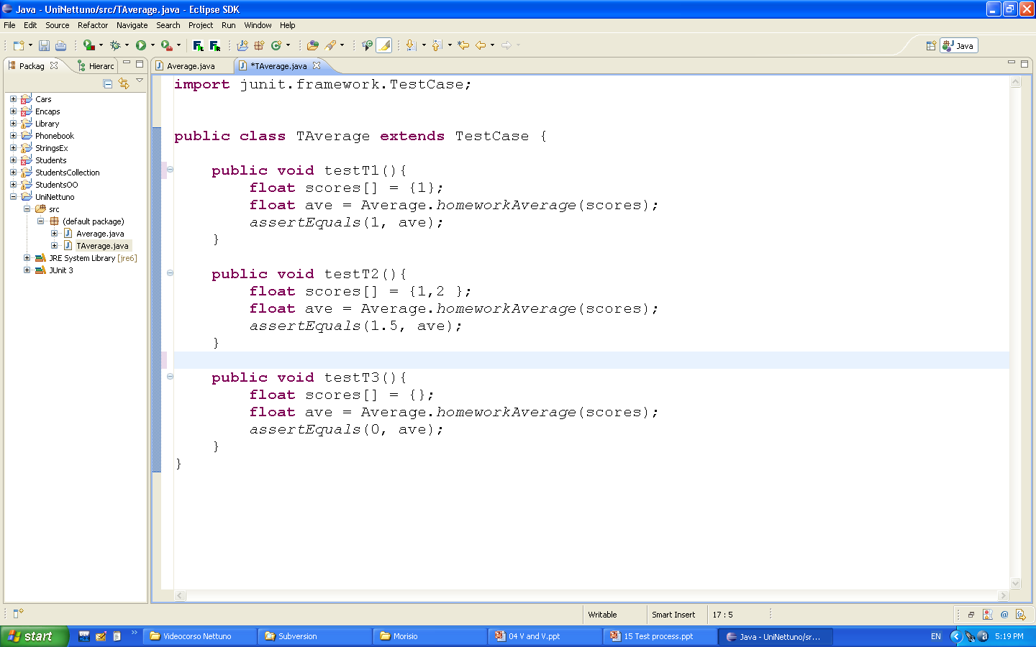
JUnit

Slide 163
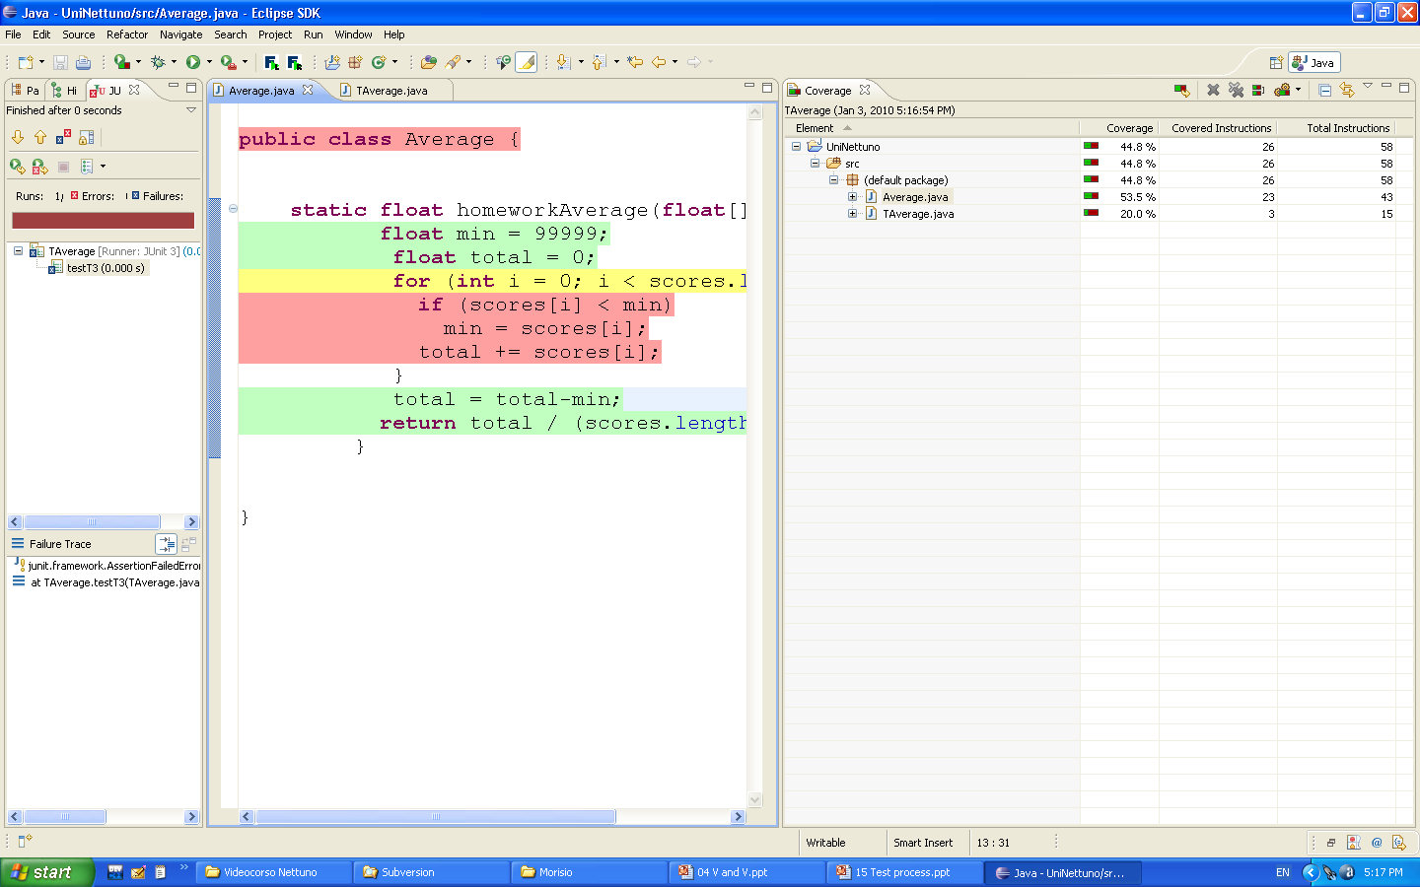
Cobertura

Slide 164
Summary
Structural / white box testing starts from the code, and uses several coverage objectives
Statements
Decisions
Conditions (simple, multiple)
Path
Loop

Slide 165
Summary
White box testing is typically made in the development environment and supported by tools to compute coverage

Slide 166
Integration test

Slide 167
Integration test
Requirements engineering
Requirement
document
VV requirements
Requirement
document
Design .
VV design
Design
document
Design
document
Implement unit
VV unit
Unit
Unit
Implement unit
Unit
VV unit
Unit
Integrate units
System
VV system
System
Project management Configuration management Quality assurance

Slide 168
Integration test
Test of some dependent units
Unit:
function (procedural languages)
class and its methods (oo languages)

Slide 169
The problem
Some units need others. How to test them?

Slide 170
The dependency graph
function1
function1() { //some code
call function2();
call function3();
// some other code}
function2() { //some code
call function4();}
function2
function3
function4

Slide 171
The problem -2
Function3, function4 have no dependency
Unit test techniques can be applied
Function1, function2 have dependencies, how to test them?
function1
function2
function3
function4

Slide 172
In fact two (related) problems
How to test ‘independently’ a function that has dependencies?
Ex Function1()
How to test the dependency?

Slide 173
Test independently a function with dependencies

Slide 174
Technique
Stubs
Try to eliminate the dependency using substitutes

Slide 175
Goal: test function2
function1
f2 driver
function2
function3
function2
function4
f4 stub

Slide 176
Stub, driver
Driver
Unit (function or class) developed to pilot another unit
Stub
Unit developed to substitute another unit (fake unit)
Also called mock ups, mocks

Slide 177
Ex. driver (JUnit)
public class ConverterTest extends TestCase {
public void testOne(){
Converter c = new Converter();
char [] str = {'1', '2','3','4','5','6', '7'};
try {
c.convert(str);
fail();
} catch (Exception e) {
assertTrue(true);
}
} }
public class Converter {
public int convert(char[] str) throws Exception {
if (str.length > 6)
throw new Exception();
int number = 0;
int digit;
int i = 0;
if (str[0] == '-')
i = 1;
for (; i < str.length; i++) {
digit = str[i] - '0';
number = number * 10 + digit;
}
if (str[0] == '-')
number = -number;
if (number > 32767 || number < -32768)
throw new Exception();
return number;
}
}

Slide 178
Stub
Must be simpler than unit substituted (trade off between simplicity and functionality)
Ex. unit = function to compute social security number from name/family name etc.
Stub = returns always same ssn
Ex. unit = catalog of products, contains thousands of them
Stub. Contains 3 products, returns one of them

Slide 180
Stub, embedded systems
Substitues sensors / actuators with pure software units
Ex, heating control system
Temperature sensor stub, rain sensor stub etc

Slide 181
Test dependencies between functions

Slide 182
Dependency defect
Two units work perfectly when isolated
Defect happens when connected

Slide 183
Ex. Dependency defect
Class Person{
public Person(String surname, String name){}
}
main() {
new Person(“John”, “Wright”)
}

Slide 184
Ex. Dependency defect
triangleSurface( float height, float base){}
main() {
triangleSurface(10, 4); // int instead of float
triangleSurface(3.1, 4.2); // exchanged base (3.1)
// and height (4.2)
}

Slide 185
Ex Dependency defect
The Mars polar lander case (1999)
double function( double metricMeasure){}
main() {
double imperialMeasure;
function( imperialMeasure);
}
UK team develops unit assuming metric input
US team calls unit assuming imperial input
Difference is small, noticed only at ‘landing’

Slide 186
Technique
Two units are tested in isolation first
Integrate them, test again
Focus on the dependency
In case of more units, integrate incrementally
In any case, avoid BIG BANG integration

Slide 187
Goal: test dependency function2-function4
function1
function2
function3
function4

Slide 188
1 test function4 (unit test)
2 test function 2, with stub for function4
f2 driver
f4 driver
function2
function4
f4 stub

Slide 189
3 integrate function 2 and 4, test the dependency
f2 driver
function2
function4

Slide 190
Other simpler option
1 test function4 (unit test)
2 integrate function2, test both
f2 driver
f4 driver
function2
function4
function4

Slide 191
Incremental integration
Goal:
Add one unit at a time, test the partial aggregate
Pro:
Defects found, most likely, come by last unit/interaction added
Con:
More tests to write, stubs/drivers to write

Slide 192
Incremental integration
Top down
Bottom up
Defined relatively to the dependency graph

Slide 193
function1
function2
function3
function4

Slide 194
Bottom up
Step 1
function4, function3 have no dependencies. Test them in isolation (unit test)
Test cases
function3
function3
Test cases
function4
function4

Slide 195
Step 2
Test function2+function4 as-if they were one unit
if defect is found, it should come
from function2 or
from interaction function1-function4
Not from function 4, that is now ‘trusted’
Test cases
Function2+4
function2
function4

Slide 196
Test cases
Step 3
Test all
if defect is found, it should come
from function1 or
from interaction function1-function2
from interaction function1-function3
Not from function 2+4, and function3, that are now ‘trusted’
function1
function2
function3
function4

Slide 197
Top down
Test cases
Step 1
function1
f2 stub
f3 stub

Slide 198
Top down
Test cases
Step 2
function1
function2
function3
f4 stub

Slide 199
Top down
Test cases
Step 3
function1
function2
function3
function4

Slide 200
Top-down
Pros
Allows early detection of architectural flaws
A limited working system is available early
Cons
Requires the definition of stubs for all lower level units
Suitable only for top-down development
Lower levels not directly observable

Slide 201
Bottom-up
Pros
Testing can start early in the development process
Lower levels are directly observable
Cons
Requires the definition of drivers for all lower level units

Slide 202
In practice
Incremental integration is a mix of top down and bottom up, trying to
Minimize stubs creation
Compromise with availability of units
(units are developed in an order suitable to the integration sequence decided)

Slide 203
Big bang integration
All functions are developed
Test is applied directly to the aggregate as-if it were a single unit
Test cases
function1
function2
function3
function4

Slide 204
Problems
When a defect is found, how to locate it?
Could be generated
by any function
function1, 2, 3, 4
by any interaction
function1 to function2, function1 to function3, function2 to function4
Interaction problems: bad parameter passed, parameter passed in wrong order, in wrong timing

Slide 205
Example
A company has employees and departments, each employee belongs to a department
Payroll
salary(ID) – returns salary given employee ID
bonus(amount) – gives bonus ‘amount’ to employees with higher sales record
Employee
name, surname, ID, salary
Department
name, id, salesPerYear
addEmployee
Employees
add employee
search employee, returns employee given ID
Departments
add department
search department, returns department given ID

Slide 206
Class diagram (1)

Slide 207
Dependencies (1)

Slide 208
Integration
Bottom up
Employee
Employees Department
Departments
Payroll
Top Down
Payroll
Departments, Employees

Slide 209
BU - 1

Slide 210
BU - 2

Slide 211
BU – 3

Slide 212
BU - 4

Slide 213
TD – 1

Slide 214
TD - 2
StubDepartment, StubEmployee probably useless, have similar complexity of Department and Employee

Slide 215
Class Diagram (2)
Notes:
Caso di ciclo

Slide 216
Dependencies (2)
Notes:
ciclo

Slide 217
Integration
Consider classes with dependency loop as single class
Not feasible if large/complex classes
Change design, split loop

Slide 218
Case 1 - BU
Next steps as for BU case

Slide 219
Hw sw integration (embedded sw)
Test software units with stubs replacing hardware (actuators, sensors)
ex: sensor temperature → sw stub
development environment (ex MS Windows on Intel cpu)
Integrate software + hardware
target environment (ex Android on ARM device)

Slide 220
Usually writing stubs for sensors / actuators implies defining a simulated / emulated model of the context of the sw application (as defined by context diagram and system design)

Slide 221
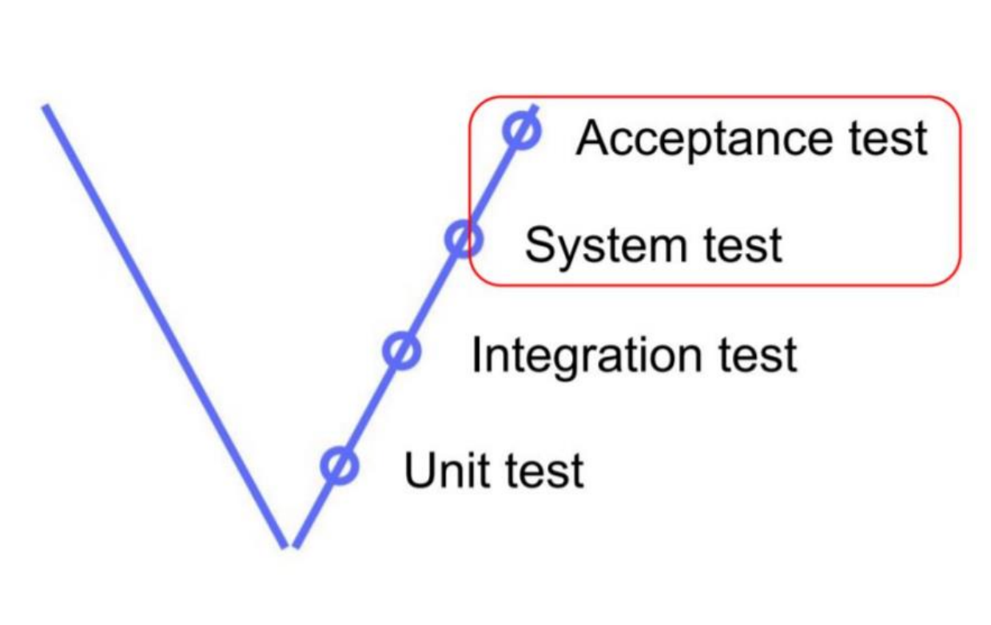
System test

Slide 222
System test
Requirements engineering
Requirement
document
VV requirements
Requirement
document
Design .
VV design
Design
document
Design
document
Implement unit
VV unit
Unit
Unit
Implement unit
Unit
VV unit
Unit
Integrate units
System
VV system
System
Project management Configuration management Quality assurance

Slide 223
System test
Test of all units composing an application
Unit:
function (procedural languages)
class and its methods (oo languages)

Slide 224
System test
Focuses on
Functional properties (functional test)
Aka last stage of integration testing
Non functional properties ( ..ilities)
Considers different platforms
Development
Production
Considers different players
Developers / testers
End users

Slide 225
System test and platforms

Slide 226
The platform
Environment where an application runs, defined by
Operating system
Database
Network
Memory
CPU
Libraries
Other applications installed
Other users
…

Slide 227
Platform and test
An element (system, unit, ..) can be tested on
Target / operation / production platform
Where the element will run for day by day use
Cannot be used for development
Risk of corrupting data
Availability
Development platform
Where the element is developed
Cannot be (in most cases) equal to the target platform

Slide 228
Platforms, examples
Embedded system
ABS for car, heating control system, mobile phone
Development platform is typically PC, external devices simulated/emulated
Information system
Bank account management, student enrollment management
Development platform is PC or workstation, database replicated in simplified form

Slide 229
What can change in system testing
Who performs it
End user (beta testing)
Developer
On what platform
Development
Target

Slide 230
System test and players

Slide 231
System test and players
Developer, development platform
Developer, target platform
End user, development platform
End user, target platform

Slide 232
System test performed by end users is also called
Acceptance testing
Context: custom development, acquirer formally accepts the system, if test is positive project ends, payments can proceed
Test cases: written by acquirer
Beta testing
Context: mass market products, subset of end users tries the product before mass market release
Test cases: informal

Slide 233
System test and test types

Slide 234
System test
Test of functional properties
Test of non functional properties

Slide 235
System test
Test of functional properties (or functional requirements)
Starting point is requirements document
Coverage of functional requirements
Coverage of use cases / scenarios
Consider usage profile (the most common, typical ways of using the system)
Cfr. Unit and integration test, goal is coverage, using all functions, all code.

Slide 236
Usage profiles
Not all functions / use cases are equal
In many commercial products end users use 5-10% of all available functions
Test more / test first the functions that are used more

Slide 237
Usage profile
Function / scenario | Frequency of usage
F1 | 10
F2 | 10
F3 | 80

Slide 238
User profiles
Advanced user profile | Function / scenario | Frequency of usage
 | F1 | 20
 | F2 | 20
 | F3 | 60
Beginner user profile | Function / scenario | Frequency of usage
 | F1 | 0
 | F2 | 10
 | F3 | 90

Slide 239
System test
Test of non functional requirements
Non functional properties are usually system, (emerging) properties. In many cases only testable when system is available
See efficiency, reliability

Slide 240
Non functional properties
Usability, reliability, portability, maintainability, efficiency (see ISO 9126)
Configuration: the commands and mechanisms to change the system
Recovery: the capability of the system to react to catastrophic events
Stress: reliability of the system under limit conditions
Security: resilience to non authorized accesses

Slide 241
System test - variants
Acceptance testing
Data and test cases provided by the customer, on target platform
Beta-testing
Selected group of potential customers

Slide 242
Test, in summary
 | Functional/non functional | Who tests | Platform | Techniques
Unit test | Functional / structural | Developer or test group | development | BB, WB
Integration test | Functional | Developer or test group | development | Incremental TD or BU
System test | Functional + non functional | Developeror test group or user | development, target | Requirement coverage Use cases coverage Nf properties

Slide 243
Testing classification (2)
 | Phase
 | Unit | Integration | System
Functional / black box | X | X | X
Structural / white box | X | dependencies
Reliability |  |  | X
Risks |  |  | X
Notes:
Functional is the most used, can be applied to all phases
Structural – only to unit (function, class) because of size of code – if 1Mloc (system) in practice unapplicable
Reliability – requires all system
risks –requires all system
Ex of reliability – apply 1000 test cases, if 2 fail then estimate p(failure) = 2/1000
Reliability – positive view - tries the main function (ex for power plant, produce energy)
Risks –negative view - tries the main risks (Ex of power plant, what if no cooling, what if earthquake..)

Slide 244
Coverage
Entities considered by at least one test case / total entities
‘Entity’ depends on type of test
Test cases
Requirement
Function
Structural element
Statement, decision, module

Slide 245
Coverage
Object tested | Coverage
Unit (class) | Methods / functions | Consider methods of the class At least one test case per method
 | Black box, partitions | Consider a method Define partitions One test case per partition
 | Black box, boundary | Define partitions One test case per boundary
 | Black box, random | Generate randomly test cases (few % of all possible inputs)

Slide 246
Coverage
Object tested | Coverage
Unit (class) | White box | Consider a method Statement coverage Decision coverage Consider a loop in a method Loop coverage

Slide 247
Coverage
Object tested | Coverage
Integration (some classes) | dependencies | At least one test case per dependency

Slide 248
Coverage
Object tested | Coverage
System (all classes) | Functional requirements | At least one test case per requirement (may correspond to testing methods of ‘main’ class at end of integration testing)
 | Scenarios | At least one test case per scenario
 | Non functional requirements | At least one test case (Junit) per non functional requirement (efficiency)
 |  | Meaningful tests for usability, portability, etc

Slide 249
Reliability testing
A variant of system testing
Aims at providing estimate of reliability = P(failure over period of time)
Other measures of reliability:
defect rate = defect/time
MTBF = mean time between defects

Slide 250
Constraints
Large number of test cases
Independent
Defect fix does not introduce other defect

Slide 251
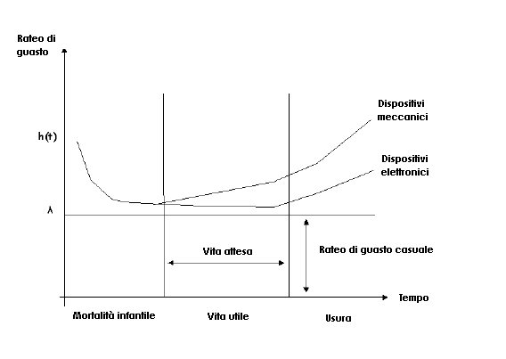
Hw reliability

Slide 252
Sw reliability
Defect rate
?
time

Slide 253
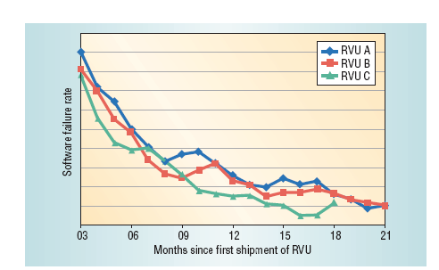
HP

Slide 254
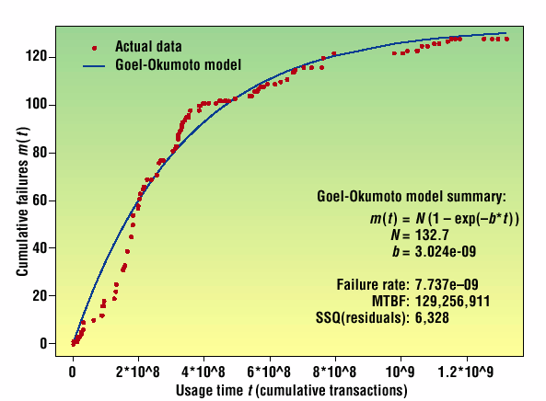
IBM application

Slide 255
Risk based testing / safety
A variant of system testing
Identify risks
Characterize risks: probability, effect
Rank risks
Handle risks

Slide 256
Ex. ABS (Anti Lock Brake)
Risks:
No brake when push pedal
Brake when no push on pedal
Push pedal and wheels block
Rank risks
Develop tests to cover more risky situations

Slide 257
User profiles based testing
Variant of risk based testing
Identify user profiles, and usage profiles
Rank them by frequency of usage
Test more more used profiles

Slide 258
Ex. MS Word
5% of functions are used by 90% of users
Focus test effort on those functions first
Ex allocate 90% of test effort on 5% of functions

Slide 259
Regression testing
Regression testing
Tests previously defined are repeated after a change
To assure that the change has not introduced defects
Time0
Element (unit, system ) in v0, test set t0 is defined and applied, all tests pass
Time1
Element is changed to v1
Test set t0 is re-applied, do all tests still pass?

Slide 260
Test, documentation and automation

Slide 261
The problem
Test cases should be not only documented
So that they are not lost, and can be reapplied
Cfr. Test cases are just invented and applied
But also automated
So that application of test cases is fast and error free
Cfr manual application of test cases

Slide 262
Informal testing
Test cases are not documented
Invent inputs on the fly, apply them, check output manually
Formal testing
Non operational (Word, excel..)
Operational (JUnit CUnit Jest Mocha etc)

Slide 263
Representing test cases
Not operational
i.e. Word document
Operational
Web page + translator to programming language
Fitnesse, FIT or SLIM
Scripting or Programming language
JS, Jest
Java, Eclipse + Junit
(similar for C, C#, http, perl,..)

Slide 264
Economics for test automation
Costs
Ew: Effort to invent test case
Ea: Effort to document and automate test case
Er: Effort to run test case

Slide 265
Automation
No automation
Iteration 1: Ew+ Ea + Er
Iteration 2: Er
Iteration 3: Er
…
Iteration n: Er
Iteration 1: Ew + Er
Iteration 2: Ew + Er
Iteration 3: Ew + Er
…
Iteration n: Ew + Er
Break even point: Ea / Ew < n -1

Slide 266
Economics of test automation
Automating a test case is worth if it is executed (without changes) many times
Rule of thumb: n > 2, 3 times

Slide 267
Goodness of test cases

Slide 268
Good test case
A good test case satisfies the following criteria:
Reasonable probability of catching an error
Does interesting things
Doesn’t do unnecessary things
Neither too simple nor too complex
Makes failures obvious
Mutually Exclusive, Collectively Exhaustive

Slide 269
Mutation testing

Slide 270
Mutation testing
Are our test cases ‘good’?
Idea:
write test cases
inject errors in program (single small change)
verify if test cases catch the errors injected

Slide 271
Mutation Testing
Mutation Testing (a.k.a., Mutation analysis, Program mutation)
Introduced in early 1970s
Used in software/hardware
Notes:
Si potrebbe parlare anche del Mutation Testing?

Slide 272
Terms
Mutant: program with one change
Killable mutant: non functionally equivalent. A test case can kill it
Equivalent mutant: functionally equivalent to program. No test case can kill it.
Mutation score:
property of a test suite (goal: 100%)
Killed non equivalent mutants / all non equivalent mutants

Slide 273
Mutations
Common mutations
Delete a statement
Swap two statements
Replace arithmetic operation
Replace boolean relation
Replace a variable
Replace boolean subexpression with constant value
Notes:
Statement deletion.
Replace each boolean subexpression with true and false.
Replace each arithmetic operation with another one, e.g. + with *, - and /.
Replace each boolean relation with another one, e.g. > with >=, == and <=.
Replace each variable with another variable declared in the same scope (variable types should be the same).

Slide 274
Mutation examples
public int sum( int a, int b )
{
return a + b;
}
public int sum( int a, int b )
{
return a + b--;
}
public int sum( int a, int b )
{
return a++ + b;
}
public int sum( int a, int b )
{
return a * b;
}
...

Slide 275
Mutations in Java
PITest

Slide 276
Testing tools
Unit / integration testing
JUnit, Mockito, Jest
GUI testing
Table based
Coverage
Eclemma, Clover, ..
Profiling

Slide 277
GUI Test tools

Slide 278
GUI testing
A variant of system testing

Slide 279
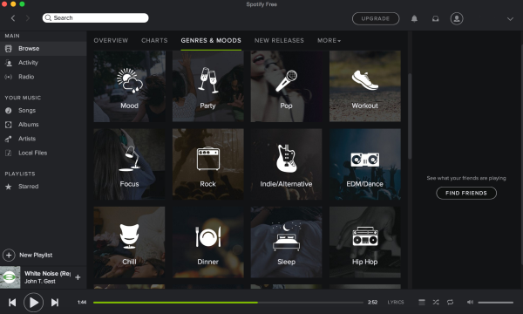
What is GUI Testing
GUI Software: any software provided with a GUI (Graphical User Interface).
GUI Testing is the practice of testing a software application through its user interface.

Slide 280
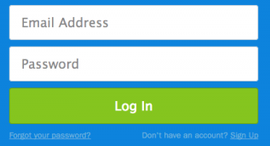
What is GUI Testing for
- Functional tests: black box tests exercising the basic functionalities of an application through interaction with the GUI, without knowing the source code.
Example:
Test that the log-in functionalities behave properly.

Slide 281
What is GUI Testing for
Look & Feel verification: GUI should appear as defined in the requirements document, or in the mockups provided by the stakeholders.
Compatibility testing: testing that the application is deployed and behaving properly on different devices, screens and layouts (device diversity).

Slide 282
Approaches to GUI Testing
Manual
Scripted
Capture & Replay
Model-based
Visual / Image Recognition

Slide 283
Manual GUI Testing
Manual execution of test scenarios (informal testing).
Easy to setup, does not require tools;
Error prone, hardly reproducible, expensive.

Slide 284
Scripted GUI Testing
Development of test scripts using dedicated scripting languages.
Scripts can be automatically executed and used for regression testing;
Test scripts can be difficult to write, and hard to maintain during the evolution of the software.

Slide 285
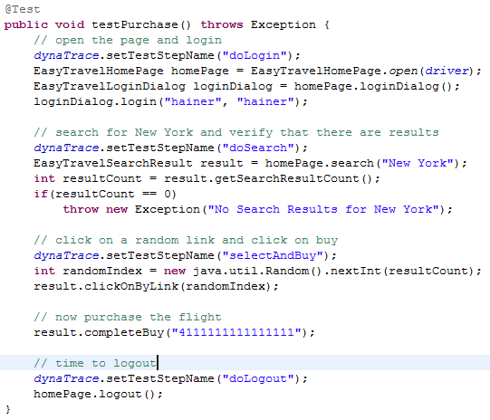


Scripted GUI Testing
Examples:
Selenium WebDriver
(web applications),
Appium Espresso (mobile).

Slide 286
Capture & Replay
User inputs are given once to the user interface (CAPTURE), and then codified into a repeatable script (REPLAY).
Faster and easier to obtain test scripts with respect to pure scripted techniques;
Very fragile to the evolution of the user interface;
Scripts must be enriched manually to perform complex operations.

Slide 287
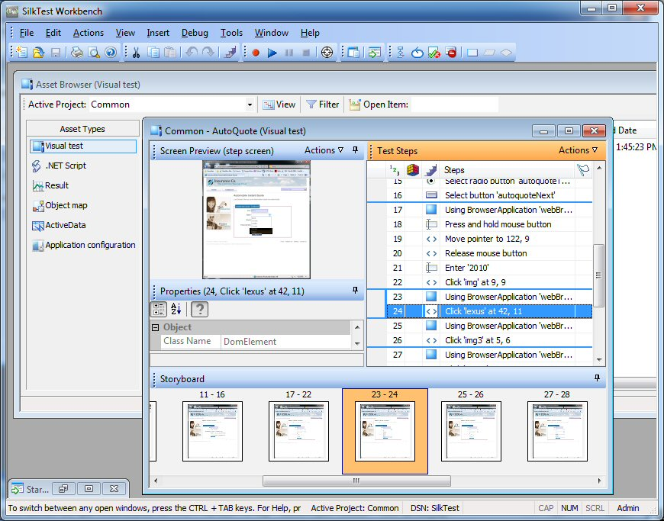


Capture & Replay
Examples:
SilkTest, HP UFT
(desktop).

Slide 288
Model-Based GUI Testing
Test cases are obtained based on models of the user interface (e.g., oriented graphs or finite state machines).
Allows automated execution and generation of use cases;
Very high coverage of use cases and functionalities can be obtainable once a model is available;
Manual effort required in defining and tailoring the GUI model.

Slide 289
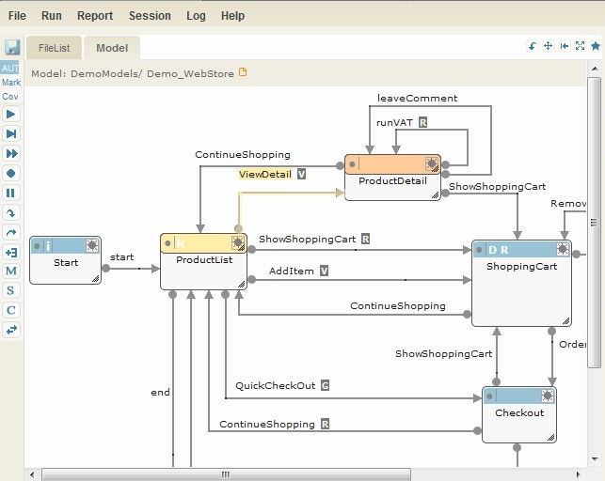


Model-Based Testing
Tools:
TestOptimal (web),
MobiGUITAR (mobile).

Slide 290
Visual Testing
Image recognition techniques are used to identify elements of the user interface to interact with.
Easy definition of test cases with no need of technical knowledge – only screen captures are needed;
Can be applied seamlessly to any kind of software provided with an (emulated) user interface;
Very high fragility to even minor changes in the GUI;
Difficult in-depth testing of application functionalities.

Slide 291
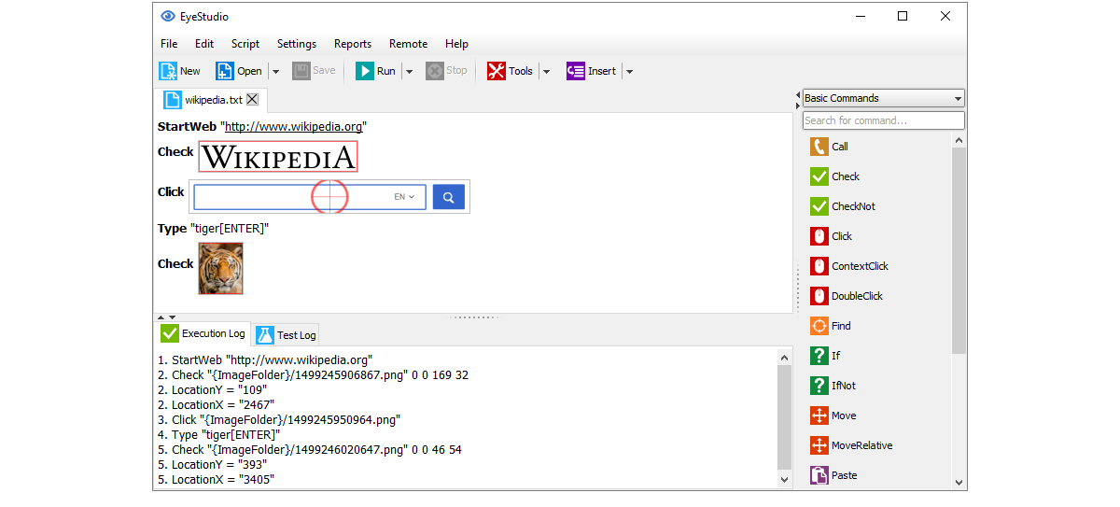


Visual Testing
Examples:
Sikuli, EyeAutomate

Slide 292
Table based

Slide 293
Table based testing
Test cases are written as tables on a wiki, and linked to the application to be tested
Pro:
Allows end users to write tests (especially acceptance tests, black box tests)
Independent of GUI
Allows automation
Cons
Requires fixtures

Slide 294
Function receives a set of words, should count number of words and occurrences of word ‘black’
input | expected |  | actual
 | word count | ‘black’ count | word count | ‘black’ count
red blue | 2 | 0
blue black green | 3 | 1
white red brown black | 4 | 1

Slide 295
FIT Framework for Integrated Test
Open source implementation of table based testing
User specifies tests in HTML tables
Developers defines fixtures to parse tables and execute tests
Fit compares tables and actual results

Slide 296
FITnesse
Standalone web page that’s hooked to FIT
Allows group to easily edit test files without worrying about ensuring the correct versions propagate out to all locations
http://fitnesse.org

Slide 297
Coverage
Show graphically and numerically coverage (statements, branches, conditions) on source code
Ex., Clover, Jcoverage, Cobertura, Eclemma, JaCoCo

Slide 298
Profilers
Trace time spent per function, given specific test execution
Performance test

Slide 299
Testing - certifications
ISTQB
www.istqb.org
Int software testing qualifications board
Delegations in most countries
In italy ita-istqb

Slide 300
ISTQB
Publishes Syllabus
Available free
Foundation, advanced, expert levels
Core, agile, specialist tracks
Provides Certifications, via exam
See foundation level

Slide 301
Static analysis
Static
inspections
source code analysis
Dynamic
testing

Slide 302
Static analysis techniques
Compilation static analysis
Control flow analysis
Data flow analysis
Symbolic execution
Reverse documentation of design

Slide 303
Compilation analysis
Compilers analyze the code checking for
Syntax correctness
Types correctness
Semantic correctness
The errors detected by a compiler strongly depend on the language
Loose vs. strongly typed languages
Static vs. dynamic visibility

Slide 304
MISRA-C
MISRA: Motor Industry Software Reliability Association
Issues Misra-C, guidelines for C programs
Issue1, 1998
127 rules, 93 compulsory
Issue2, 2004
141 rules, 121 compulsory

Slide 305
Rules, examples
5 Use only characters in the source character set. This excludes the characters $ and @, among others.
22 Declarations of identifiers denoting objects should have the narrowest block scope unless a wider scope is necessary.
34 The operands of the && and || operators shall be enclosed in parenthesis unless they are single identifiers.
67 Identifiers modified within the increment expression of a loop header shall not be modified inside the block controlled by that loop header.
103 Relational operators shall not be applied to objects of pointer type except where both operands are of the same type and both point into the same object.

Slide 306
Rule 5
signed char dollar = ’$’;
not accepted
signed char esc_m = ’\m’;
not accepted (what would be the associated behaviour to this escape sequence?)

Slide 307
Rule 34
if ((var++) || (num == 11)){...} /* OK */
if (var++ || num == 11){...} /* NOT OK */
if ((vect[num]==4) && (num == 11)){...} /* OK */
if (vect[num] == 4 && (num == 11)){...} /* NOT OK */
if ((structure.field != 0) && (num < 11)){...} /* OK */

Slide 308
Rule 67
for (int i = 0; i< max; i++){
i=i+1; // NO
}

Slide 309
Misra static analyzers
Parse source code and check if rules are violated
QA-C by Programming Research, is a full featured MISRA C1 and C2 validator.
Testbed by LDRA, offers a static and dynamic analysis.
PC-Lint by Gimpel, is one of the fastest and least expensive validtors.
DAC by Ristan-CASE, provides a reverse engineering, documentation and code analyzer.

Slide 310
Bad Smells (Fowler)
Fowler et al., Refactoring, Improving quality of existing code

Slide 311
Bad smells
Duplicated code
Long method
Large class
Long parameter list
Divergent change
Shotgun surgery
Feature envy
Data clumps
Primitive obsession
Switch statements
Parallel inheritance hierarchies
Lazy class
Speculative generality
Temporary field
Message chain
Middle man
Inappropriate intimacy
Alternative classes with different interfaces
Incomplete Library class
Data class
Refused bequest
Comments

Slide 312
Java analyzers
PMD
pmd.sourceforge.net
Findbug
findbug.sourceforge.net

Slide 313

PMD
JavaCC-generated
parser
For each rule
ruleset
InputStream
AST
filename
Rules violations

Slide 314
PMD, rules
empty try/catch/finally/switch statements...
Dead code - unused local variables, parameters and private methods...
Suboptimal code - wasteful String/StringBuffer usage...
Overcomplicated expressions - unnecessary if statements, for loops that could be while loops...
Duplicate code - copied/pasted code means copied/pasted bugs

Slide 315
If (true) {
}
Else{ }

Slide 316
Findbug, rules
Correctness bug:
Probable bug - an apparent coding mistake resulting in code that was probably not what the developer intended.
Bad Practice
Violations of recommended and essential coding practice. Examples include hash code and equals problems, cloneable idiom, dropped exceptions, serializable problems, and misuse of finalize.
Dodgy
Code that is confusing, anomalous, or written in a way that leads itself to errors. Examples include dead local stores, switch fall through, unconfirmed casts, and redundant null check of value known to be null.

Slide 317
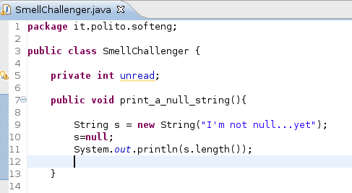
PMD and FIND BUGS: let's try!
Let's run the plugins with the following piece of code

Slide 318

Results comparison
private int unread;
public void
print_a_null_string(){
String s = new String
("I'm not null...yet");
Avoid unused
private fields
Unused
field
Methods names should
not contain underscores
Avoid instantiating
String objects: it's
usually unnecessary
Dead store to variable s
Invokes inefficient
new String(String)‏
constructor
Avoid variables
with short names

Slide 319
Results comparison
s=null;
System.out.println
(s.length());
}
Anomaly: A recently defined variable is
redefined. This is ominous but don't
have to be a bug.
Assigning an Object to null
is a code smell.
Consider refactoring.
System.(out|err).print is
used, consider using a
logger.
Null point
deference of s
Load of known null value

Slide 320
Data flow analysis
Analyzes the values of variables during execution to find out anomalies
Looks like dynamic but some information can be collected statically
Three operations on variables
Definition: - write- a new value is assigned
Use: - read- the value of the variable is read
Nullification: the variable has no significant value

Slide 321
Data flow analysis
Correct sequences
D U
The use of a variable must be always preceded by a definition of the same variable
Suspect (forbidden) sequences
D D
N U
A use of a variable not preceded by a definition corresponds to the use of an undefined value

Slide 322
Data flow analysis
Tools recover the sequence and recognize suspect ones
 | x1 | x2 | x
void swap(float*x1, float* x2){ | D | D | -
int float x; | - | - | N
*x2 = x; | - | D | U
*x2 = *x1; | U | D | -
*x1 = x; | D | - | U
}
x = *x2;

Slide 323
Symbolic execution
The program is executed with symbolic values instead of actual values
Output variables are expressed as symbolic formulas of input variables
Symbolic execution may be extremely complex even for simple programs

Slide 324
Symbolic execution
1 integer product (int x, int y, int z){
2 int tmp1, tmp2;
3 tmp1 = x*y;
4 tmp2 = y*z;
5 return tmp1 * tmp2 / y;
6 }
Stmt | x | y | z | tmp1 | tmp2 | product
2 | X | Y | Z | ? | ? | ?
3 | X | Y | Z | X*Y | ? | ?
4 | X | Y | Z | X*Y | Y*Z | ?
5 | X | Y | Z | X*Y | Y*Z | X*Y*Y*Z / Y

Slide 325
Reverse documentation of design / code
Over time the code changes and may or may not correspond to the initial design
How to reconstruct the actual, current design?
Code base
Reverse design tool
Design

Slide 326
Testing and quality
Analysis of defects found in a software project is a key tool to assess the quality of a software product
See before ‘reliability testing’
See chapter on project management

Slide 327
Tools
Structure 101

Slide 328
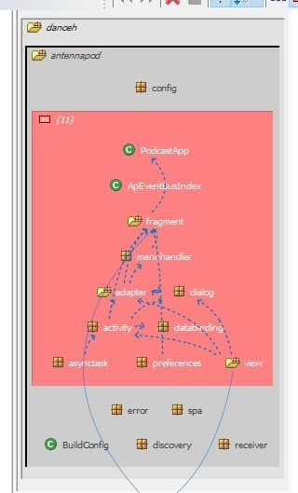

Slide 329
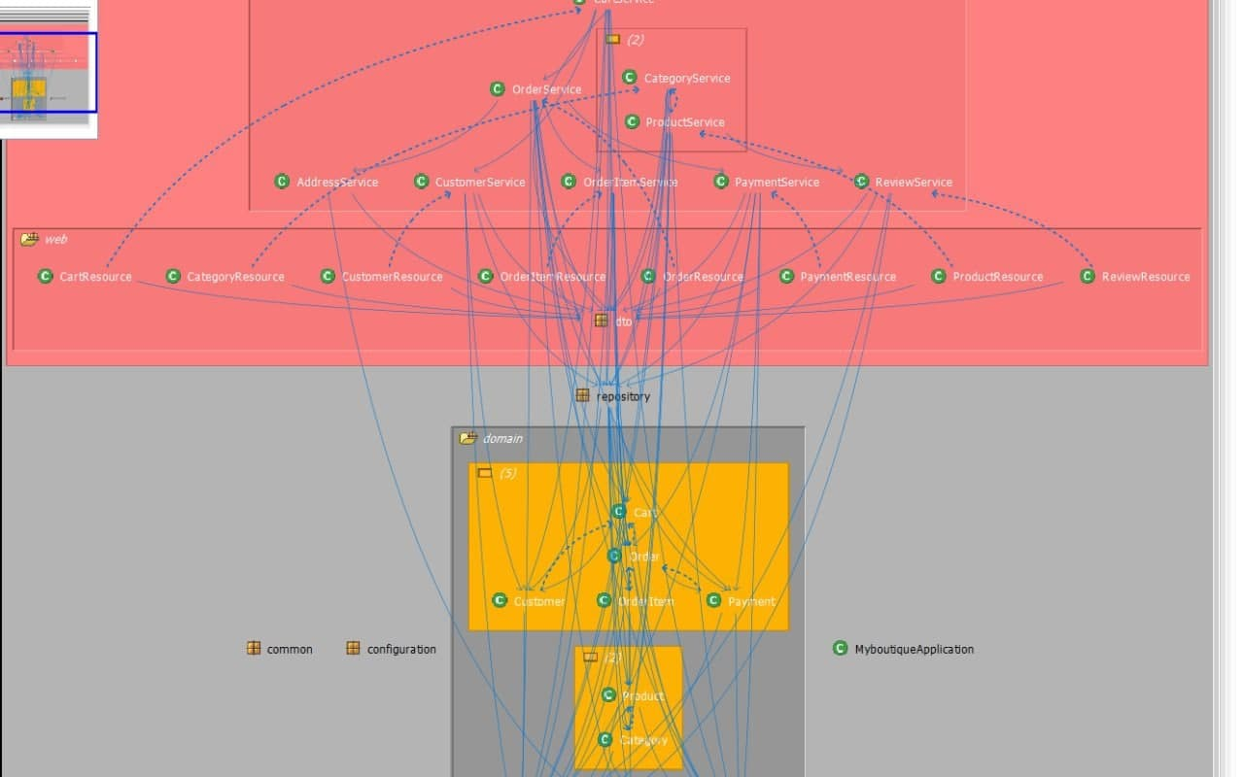

Slide 330
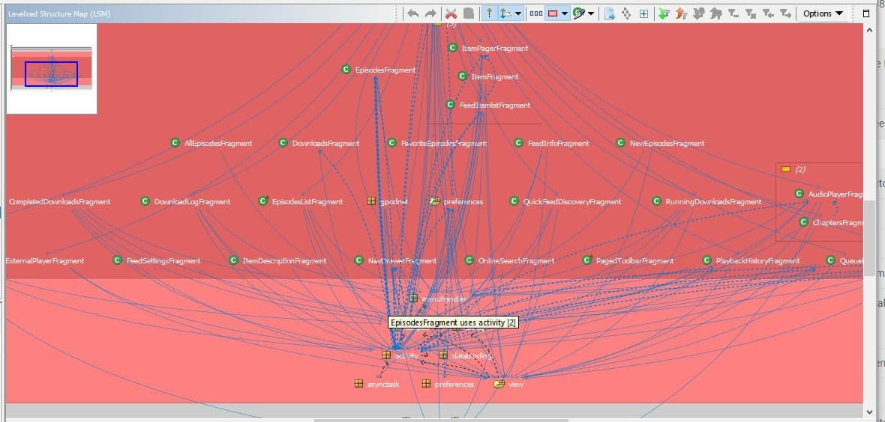

Slide 331
Summary
VandV is about preventing, finding and fixing defects
Many techniques available: testing, inspection, static analysis
Cost and effort of VandV should be compared with cost of defects left to the end user
Cost of quality vs. cost of non quality

